Slide 1
7 Deadly Questions
By: James Zartman

Slide 2
The Questions
Using MultiSim, Excel and hand calculations create a set of notes that show how to:
1.) Multiple resistors combine in series and parallel.
2.) By example calculate RT, IT, PT, and all the nodal voltages, branch currents and power
dissipation of a resistor network.
3.) By example calculate the Thevenin Resistance and Voltage of a resistor network.
4.) Multiple capacitors combine in series and parallel.
5.) Multiple inductors combine in series and parallel.
6.) Using a simple RC circuit determine the
a.) Time Constant (not needed)
b.) Create a graph that shows the RC time constant as a function of time (not needed)
c.) Determine XC at a fixed frequency
d.) Create a graph that shows how XC changes as a function of frequency
e.) Plot the frequency response
7.) Using a simple RL circuit determine the
a.) Time Constant (not needed)
b.) Create a graph that shows the RL time constant as a function of time (not needed)
c.) Determine XL at a fixed frequency
d.) Create a graph that shows how XL changes as a function of frequency
e.) Plot the frequency response

Slide 3
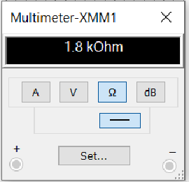
Question #1
Multiple resistors combined in series and parallel
There is only one real way to get the total resistance when the resistors of a circuit are all in series.
Add them up.. R_{T} = R₁ + R₂ + R₃ … + R_{n} Where n = the number of resistors
As you can see the simulation in multisim and the calculation in excel are both in agreement in the that the total resistance is 1.8kohm
R1= | 1.0E+3 | Ω
R2= | 330 | Ω
R3= | 470 | Ω
RT= | 1.8E+3 | Ω
RT= | R1+R2+R3

Slide 4
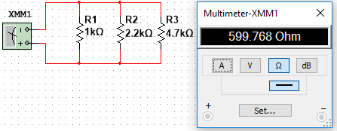
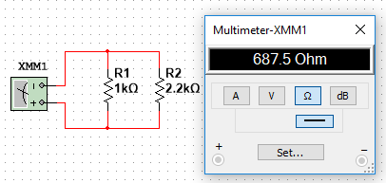
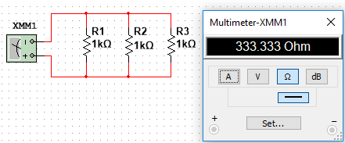
Question #1
Multiple resistors combined in series and parallel
When working with a circuit with resistors in parallel there are more options in how we solve for the total resistance
  More than 3 unequal resistors called the reciprocal method (can be used for any # of resistors equal or not)
  Two unequal value resistors called Product over sum rule
  Multiple equal value resistors called Equal value branches
R1= | 1.0E+3
R2= | 1.0E+3
R3= | 1.0E+3
Rx= | 1.0E+3
n= | 3.0E+0
RT= | 333.3E+0
RT= | B4/B5
R1= | 1.0E+3
R2= | 2.2E+3
R3= | 4.7E+3
RT= | 599.8
R1= | 1.0E+3
R2= | 2.2E+3
RT= | 687.50
RT= | (B1*B2)/(B1+B2)
Reciprocal method
Product over sum rule
Of 2 unequal resistors
Multiple equal value resistors

Slide 5
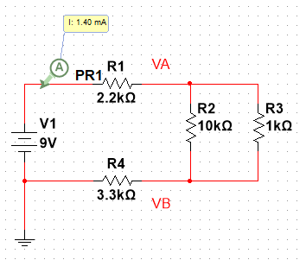
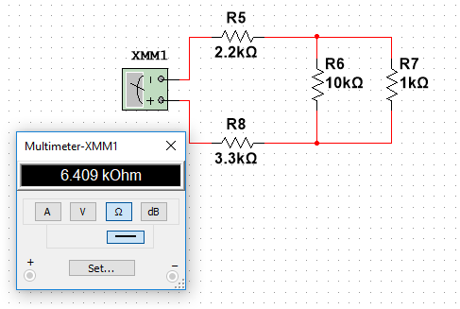
Question #2
By example calculate RT, IT, PT, and all the nodal voltages, branch currents and power dissipation of a resistor network.
To show RT, IT, and PT we will use this simple series parallel circuit with a 9 volt DC power source.
  RT is solved by first calculating the resistance of R2 and R3 by using product over sum rule. Then take that and add R1 and R4 to the value of R23.
  Current is found by I=V/R
  As you can see the values calculated are verified in Multisim.
 | A | B | C
1 | V= | 9
2 | R1= | 2.2E+3
3 | R2= | 10.0E+3
4 | R3= | 1.0E+3
5 | R4= | 3.3E+3
6 | R23= | 909.1E+0 | (B3*B4)/(B3+B4)
7 | RT= | 6.4E+3 | SUM(B6+B5+B2)
8 | IT= | 1.4E-3 | B1/B7

Slide 6
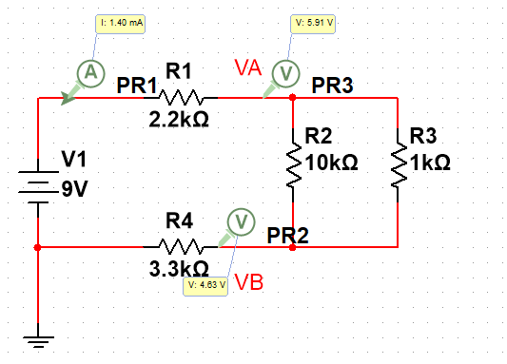
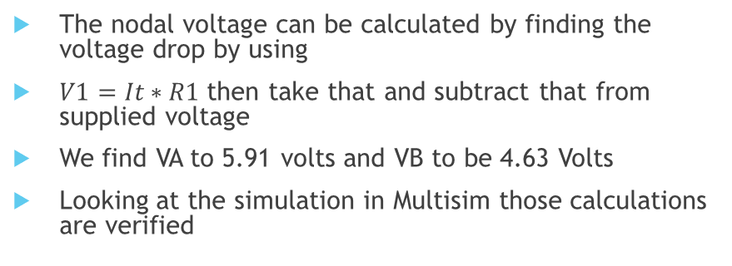
Question #2
By example calculate RT, IT, PT, and all the nodal voltages, branch currents and power dissipation of a resistor network.
Total power can be calculated three different ways
We find that the total power is equal to 12.6E-3 watts
The nodal voltage can be calculated by finding the voltage drop by using
$V1=It∗R1$ then take that and subtract that from supplied voltage
We find VA to 5.91 volts and VB to be 4.63 Volts
Looking at the simulation in Multisim those calculations are verified
 | A | B | C
1 | V= | 9
2 | R1= | 2.2E+3
3 | R2= | 10.0E+3
4 | R3= | 1.0E+3
5 | R4= | 3.3E+3
6 | R23= | 909.1E+0 | (B3*B4)/(B3+B4)
7 | RT= | 6.4E+3 | SUM(B6+B5+B2)
8 | IT= | 1.4E-3 | B1/B7
9 | PT= | 12.6E-3 | B8*B1
10 | PT= | 12.6E-3 | (B8^2)*B7
11 | PT= | 12.6E-3 | (B1^2)/B7
V= | 9
R1= | 2.2E+3
R2= | 10.0E+3
R3= | 1.0E+3
R4= | 3.3E+3
R23= | 909.1E+0 | (B3*B4)/(B3+B4)
RT= | 6.4E+3 | SUM(B6+B5+B2)
IT= | 1.4E-3 | B1/B7
PT= | 12.6E-3 | B8*B1
PT= | 12.6E-3 | (B8^2)*B7
PT= | 12.6E-3 | (B1^2)/B7
V1= | 3.1E+0 | B8*B2
VA=V-V1= | 5.91E+0 | B1-B12
VB= | 4.63E+0 | B8*B5

Slide 7
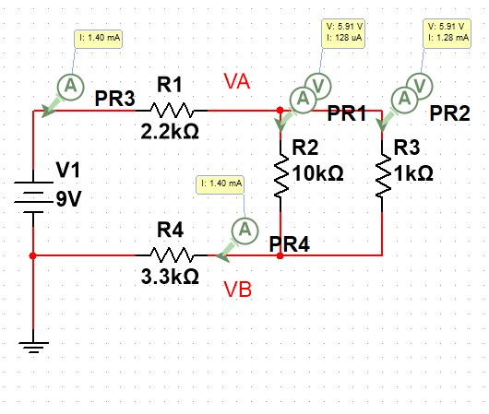

Question #2
By example calculate RT, IT, PT, and all the nodal voltages, branch currents and power dissipation of a resistor network.
Before we can find the power dissipation of each resistor we have to figure out the currents of each branch
  To do this we use the current divider rule
    $Ix=\frac{Rt}{Rx+Rt}∗It$
  As we can see from simulation in Multisim the
  Calculations match .
 | A | B | C
1 | V= | 9
2 | R1= | 2.2E+3
3 | R2= | 10.0E+3
4 | R3= | 1.0E+3
5 | R4= | 3.3E+3
6 | R23= | 909.1E+0 | (B3*B4)/(B3+B4)
7 | RT= | 6.4E+3 | SUM(B6+B5+B2)
8 | IT= | 1.4E-3 | B1/B7
9 | PT= | 12.6E-3 | B8*B1
10 | PT= | 12.6E-3 | (B8^2)*B7
11 | PT= | 12.6E-3 | (B1^2)/B7
12 | V1= | 3.1E+0 | B8*B2
13 | VA=V-V1= | 5.91E+0 | B1-B12
14 | VB= | 4.63E+0 | B8*B5
15 | I1= | 1.4E-3 | B1/B7
16 | I2= | 127.7E-6 | (B8*B4)/(B3+B4)
17 | I3= | 1.28E-3 | (B8*B3)/(B3+B4)
18 | I4= | 1.4E-3 | B1/B7

Slide 8
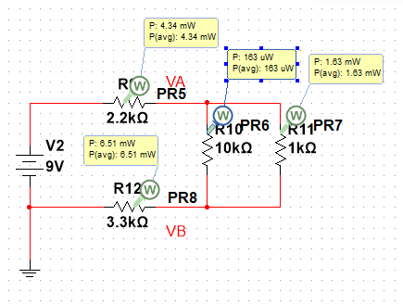
Question #2
By example calculate RT, IT, PT, and all the nodal voltages, branch currents and power dissipation of a resistor network.
Now that we know the branch currents we can figure out the power dissipation of the resistor network
  Use Px=Ix² * Rx
The calculations match
the simulation
 | A | B | C
1 | V= | 9
2 | R1= | 2.2E+3
3 | R2= | 10.0E+3
4 | R3= | 1.0E+3
5 | R4= | 3.3E+3
6 | R23= | 909.1E+0 | (B3*B4)/(B3+B4)
7 | RT= | 6.4E+3 | SUM(B6+B5+B2)
8 | IT= | 1.4E-3 | B1/B7
9 | PT= | 12.6E-3 | B8*B1
10 | PT= | 12.6E-3 | (B8^2)*B7
11 | PT= | 12.6E-3 | (B1^2)/B7
12 | V1= | 3.1E+0 | B8*B2
13 | VA=V-V1= | 5.91E+0 | B1-B12
14 | VB= | 4.63E+0 | B8*B5
15 | I1= | 1.4E-3 | B1/B7
16 | I2= | 127.7E-6 | (B8*B4)/(B3+B4)
17 | I3= | 1.28E-3 | (B8*B3)/(B3+B4)
18 | I4= | 1.4E-3 | B1/B7
19 | P1= | 4.3E-3 | B15^2*B2
20 | P2= | 163.0E-6 | B16^2*B3
21 | P3= | 1.63E-3 | B17^2*B4
22 | P4= | 6.5E-3 | B18^2*B5

Slide 9
Question #3
By example calculate the Thevenin Resistance and Voltage of a resistor network.
The goal of this theorem is to find an equivalent circuit that isn’t as complex
This theorem uses two basic steps
Step 1 remove the load resistor and determine the voltage that would appear across the load terminals. This will be called V_{TH} in the next slide it is R5 that we remove to be V_{TH}
Step 2 short the source then looking back towards the source (battery) determine the total resistance. This will be called R_{TH} this is the circuit on next slide that is in the lower left corner
Combine the R_{TH} and V_{TH} together and the resulting circuit is the equivalent Thevenin circuit. On next slide in the lower right corner.
You can see on the next slide the step by step process through the circuits going left to right starting at the top.
We see that our load resistor was actually R5 in the upper left circuit and we remove that one to continue figuring out the equivalent circuit.

Slide 10
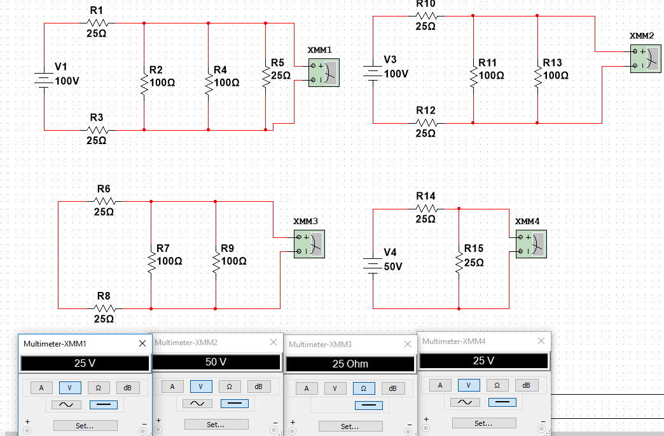
Question #3
By example calculate the Thevenin Resistance and Voltage of a resistor network.
 | A | B
1 | V= | 100
2 | R1= | 25
3 | R2= | 100
4 | R3= | 25
5 | R4= | 100
6 | RL= | 25
7 | R24= | 50 | 1/((1/B3)+(1/B5))
8 | RTH= | 25 | 1/((1/B7)+(1/(B2+B4)))
9 | IT= | 4 | B1/B8
10 | VTH= | 50 | (B1*B5)/(B1+B5)

Slide 11
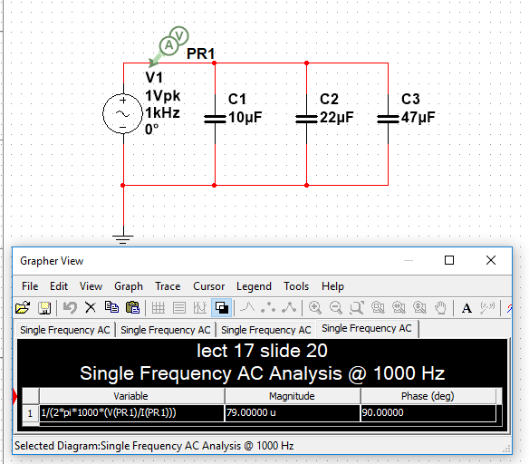
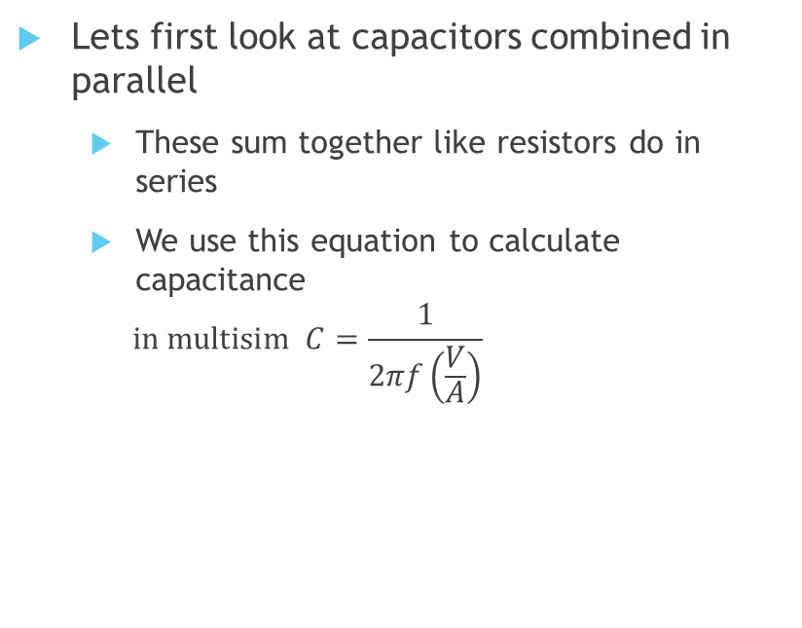
Question #4
Multiple capacitors combine in series and parallel.
Lets first look at capacitors combined in parallel
  These sum together like resistors do in series
  We use this equation to calculate capacitance
  $$in multisim C=\frac{1}{2πf\left(\frac{V}{A}\right)}$$
 | A | B | C
1 | c1= | 10.0E-6
2 | c2= | 22.0E-6
3 | c3= | 47.0E-6
4 | CT in parallel= | 79.0E-6 | SUM(B1:B3)

Slide 12
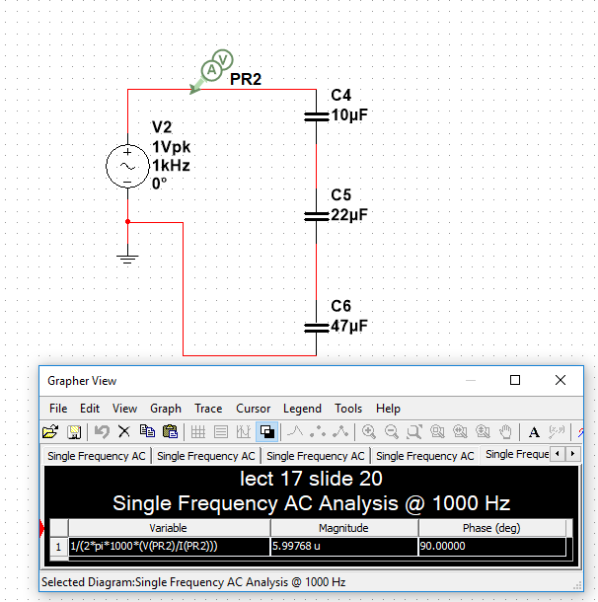

Question #4
Multiple capacitors combine in series and parallel.
Now lets look at capacitors combined in series
  These combine together like resistors in parallel
  We use this equation to calculate capacitance
  $$in multisim C=\frac{1}{2πf\left(\frac{V}{A}\right)}$$
 | A | B | C
1 | c1= | 1.0E-6
2 | c2= | 2.2E-6
3 | c3= | 4.7E-6
4 | CT in series = | 5.998E-6 | 1/((1/B1)+(1/B2)+(1/B3))

Slide 13
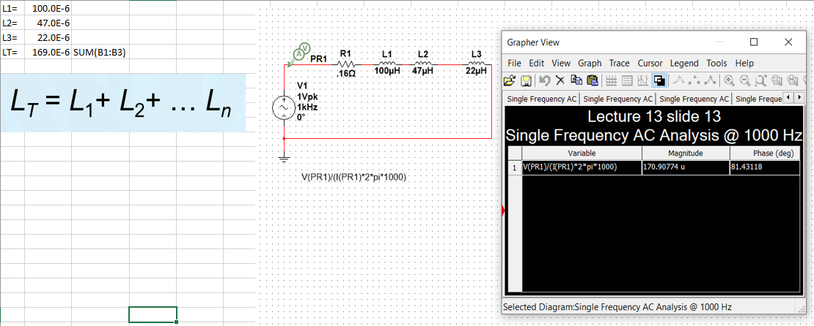
Question #5
Multiple inductors combine in series and parallel.
First lets look at Inductors combined in series
  These combine together like resistors do in series

Slide 14
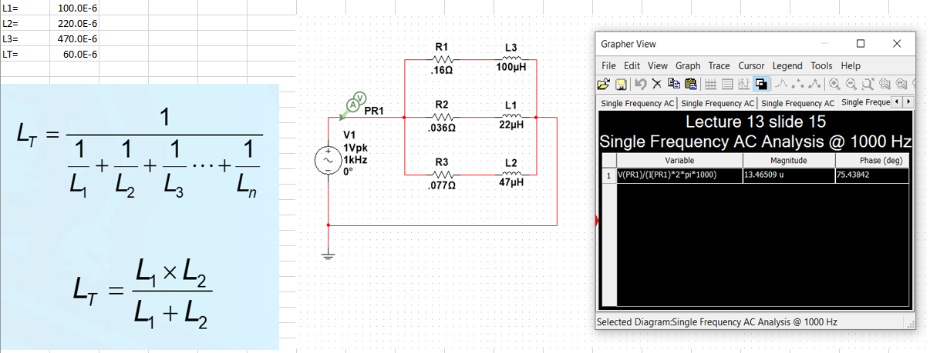
Question #5
Multiple inductors combine in series and parallel.
Now lets look at inductors in parallel
  These combine like resistors do in parallel by reciprocal method and product over sum rule

Slide 15
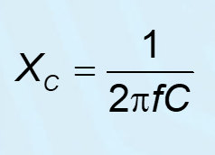
Question #6
Using a simple RC circuit determine
Determine X_{c} at a certain frequency and create a graph that shows how X_{c} changes as a function of frequency
Below we see that a 47uF capacitor at a frequency of 100 hz the X_{c} is equal to 3.4E+3
 | A | B | C
1 | C= | 4.70E-07
2 | f | Xc
3 | 100.0E+0 | 3.4E+3 | 1/(2*PI()*(A3)*(B1))

Slide 16
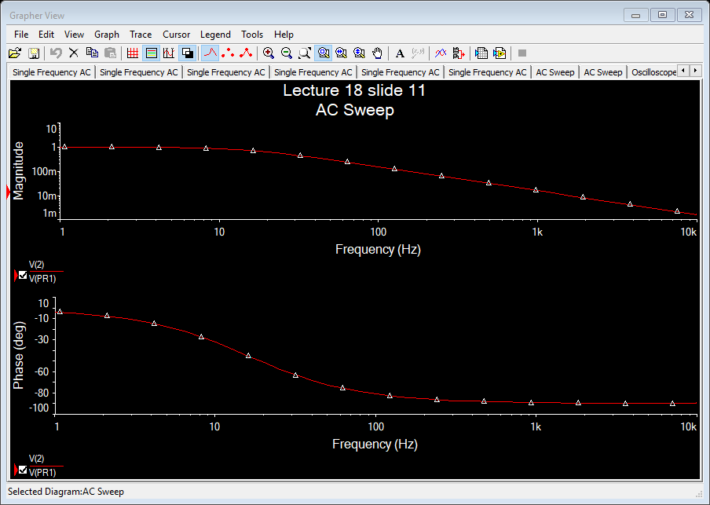
Question #6
Using a simple RC circuit determine
Plot the frequency response

Slide 17
Question #7
Using a simple RL circuit determine
XL at a certain frequency and graph
  We see below that XL of 100uH inductor at 1000Hz is 628.3m ohms
Create a graph that shows how XL changes as a function of frequency
L1= | 100.0E-6 |  | XL1= | 628.3E-3
L2= | 47.0E-6 |  | XL2= | 295.3E-3
L3= | 22.0E-6 |  | XL3= | 138.2E-3
LT= | 169.0E-6 |  | XLT= | 1.06
F= | 1.0E+3 |  | XLT= | 1.06

Slide 18
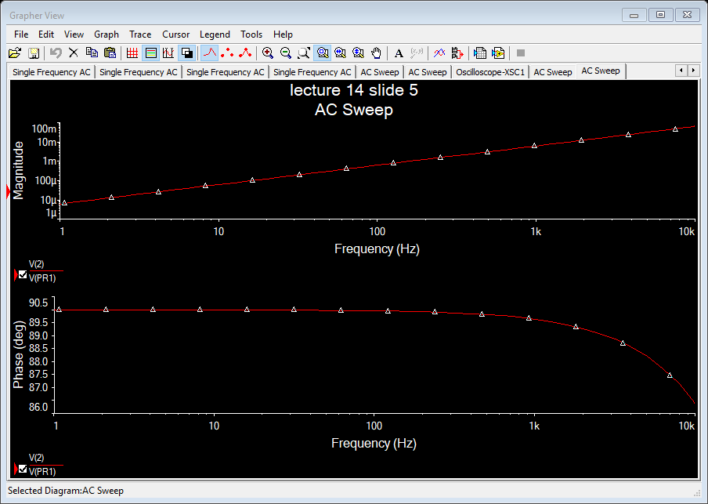
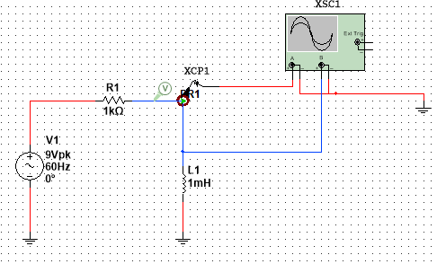
Question #7
Using a simple RL circuit determine
Plot the frequency response

